Slide 1
ARTIFICIAL INTELLIGENCE
&
MACHINE LEARNING
UNIT-1
ARTIFICIAL INTELLIGENCE

Slide 2
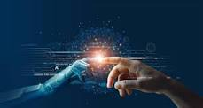
Artificial Intelligence – Overview
What is Artificial Intelligence?
Artificial Intelligence is a way of making a computer, as computer-controlled robot, or a software think intelligently, in the similar manner the intelligent humans think.
AI is accomplished by studying how human brain thinks, and how humans learn, decide, and work while trying to solve a problem, and then using the outcomes of this study as a basis of developing intelligent software and systems.
The term artificial intelligence was first coined decades ago in the year 1956 by John Mctarty at the Dartmouth conference.
He defined artificial intelligence as the science and engineering of making intelligent machines.

Slide 3
Artificial Intelligence - Overview
Many AI applications, are not perceived as AI because we often tend to think of AI as robots doing our daily jobs.
But the truth is artificial intelligence has found its way into our daily lives. It has become so general that we don’t realize we use it all the time.
For instance Google is able to give you accurate search results.
Facebook feed always gives you content based on your interest. This is because of the application of artificial intelligence.

Slide 4
  Philosophy of AI
While exploiting the power of the computer systems, the curiosity of human, lead him to wonder, “Can a machine think and behave like humans do?”
Thus, the development of AI started with the intention of creating similar intelligence in machines that we find and regard high in humans.

Slide 5
  Why Artificial Intelligence?
Before Learning about Artificial Intelligence, we should know that what is the importance of AI and why should we learn it. Following are some main reasons to learn about AI:
With the help of AI, you can create such software or devices which can solve real-world problems very easily and with accuracy such as health issues, marketing, traffic issues, etc.
With the help of AI, you can create your personal virtual Assistant, such as Cortana, Google Assistant, Siri, etc.
With the help of AI, you can build such Robots which can work in an environment where survival of humans can be at risk.
AI opens a path for other new technologies, new devices, and new Opportunities.

Slide 6
  Goals of AI
To Create Expert Systems − The systems which exhibit intelligent behavior, learn, demonstrate, explain, and advice its users.
To Implement Human Intelligence in Machines − Creating systems that understand, think, learn, and behave like humans.

Slide 7
Expert Systems
Expert systems are computer programs designed to simulate the decision-making ability of a human expert.
These systems are capable of performing complex tasks — like diagnosing diseases, recommending treatments, or guiding financial decisions — just like a human specialist would.
They can
Learn from past data,
Demonstrate** reasoning and logic,
Explain their conclusions,
And even advise users on the best course of action.
For example, a medical expert system like IBM Watson can analyze patient symptoms, compare them with a vast database of medical knowledge, and suggest a diagnosis — just as a highly experienced doctor might.

Slide 8
Implement Human Intelligence in Machines
This involves several key aspects:
Understanding language, images-- and sounds — for example, Siri or Alexa understanding your voice commands.
Thinkingand making decisions — like how self-driving cars evaluate traffic conditions and make split-second driving decisions.
Learning from experience — just like how Netflix learns your preferences and recommends shows you’re likely to enjoy.
And most importantly--behaving intelligently in a wide range of real-world situations.
So in short, this goal is about making machines that can perceive their environment, reason through problems, and adapt over time, much like a human being.

Slide 9
  What Contributes to AI?
Artificial intelligence is a science and technology based on disciplines such as
Computer Science
Biology
Psychology
Linguistics
Mathematics
Engineering

Slide 10
The major thrust of AI:
A major thrust of AI is in the development of computer functions associated with human intelligence, such as
Reasoning---To reason is to draw inferences appropriate to the situation.
1. Cricket ground is wet if it is raining
Axiom: Cricket ground is wet.
Conclusion It is raining.
2. Common Sense reasoning: If I put my hand in a fire, then it will burn.
Learning--The simplest is learning by trial and error.
Problem solving---1.Tailor-made for a particular problem
2. General-purpose method is applicable to a wide variety of problems.

Slide 11
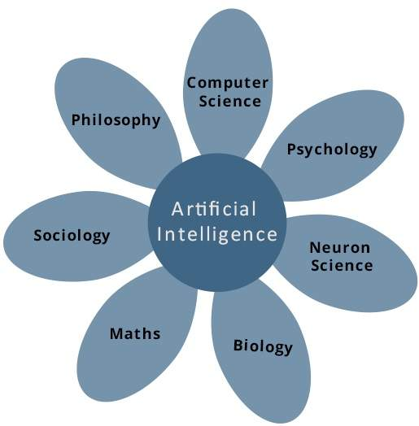
The major thrust Areas of AI:

Slide 12
  Advantages of Artificial Intelligence
High Accuracy with less errors: AI machines or systems are prone to less errors and high accuracy as it takes decisions as per pre-experience or information.
High-Speed: AI systems can be of very high-speed and fast-decision making, because of that AI systems can beat a chess champion in the Chess game.
High reliability: AI machines are highly reliable and can perform the same action multiple times with high accuracy.
Useful for risky areas: AI machines can be helpful in situations such as defusing a bomb, exploring the ocean floor, where to employ a human can be risky.
Digital Assistant: AI can be very useful to provide digital assistant to the users such as AI technology is currently used by various E-commerce websites to show the products as per customer requirement.
Useful as a public utility: AI can be very useful for public utilities such as a self-driving car which can make our journey safer and hassle-free, facial recognition for security purpose, Natural language processing to communicate with the human in human-language, etc.

Slide 13
Disadvantages of Artificial Intelligence
High Cost: The hardware and software requirement of AI is very costly as it requires lots of maintenance to meet current world requirements.
Can't think out of the box: Even though we are making smarter machines with AI, but still they cannot work out of the box, as the robot will only do that work for which they are trained, or programmed.
Increase dependency on machines: With the increment of technology, people are getting more dependent on devices and hence they are losing their mental capabilities.

Slide 14
No feelings and emotions: AI machines can be an outstanding performer, but still it does not have the feeling so it cannot make any kind of emotional attachment with human, and may sometime be harmful for users if the proper care is not taken.
No Original Creativity: As humans are so creative and can imagine some new ideas but still AI machines cannot beat this power of human intelligence and cannot be creative and imaginative.

Slide 15
  THANK YOU

Slide 16
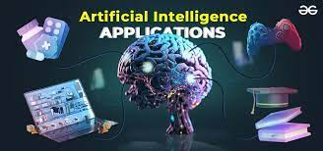
Applications of AI

Slide 17
Applications of AI
Artificial Intelligence has various applications in today's society. It is becoming essential for today's time because it can solve complex problems with an efficient way in multiple industries, such as Healthcare, entertainment, finance, education, etc. AI is making our daily life more comfortable and fast.
Following are some sectors which have the application of Artificial Intelligence

Slide 18
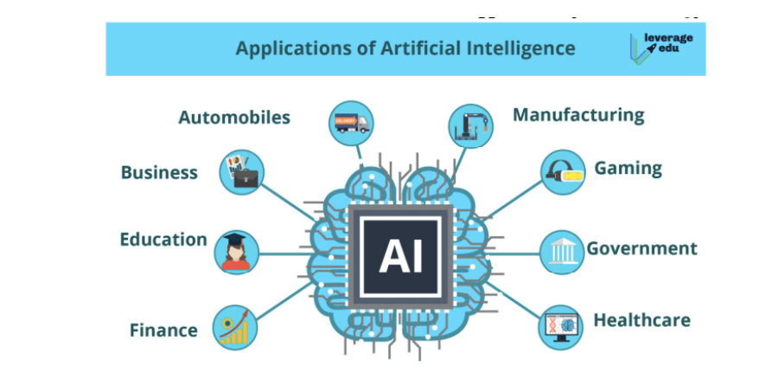

Slide 19
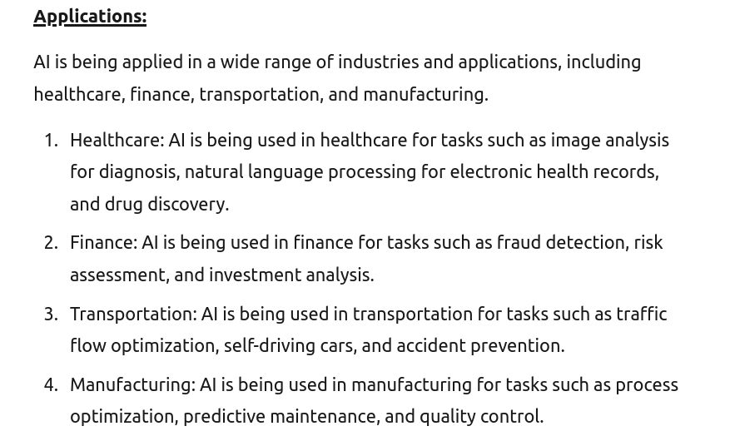

Slide 20
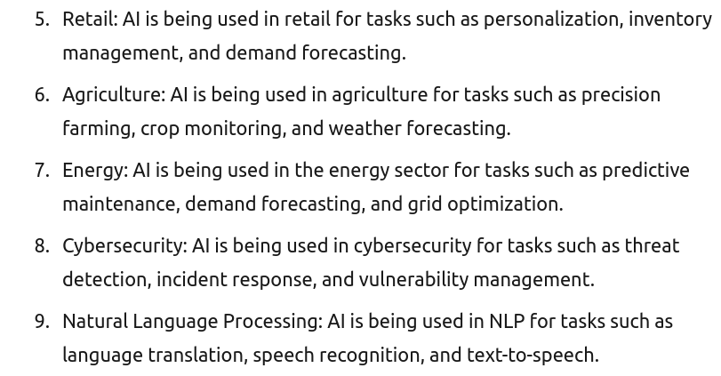

Slide 21
• Gaming − AI plays crucial role in strategic games such as chess, poker, tic-tac-toe, etc., where machine can think of large number of possible positions based on heuristic knowledge.
• Natural Language Processing − It is possible to interact with the computer that understands natural language spoken by humans.
• Expert Systems − There are some applications which integrate machine, software, and special information to impart reasoning and advising. They provide explanation and advice to the users.
• Vision Systems − These systems understand, interpret, and comprehend visual input on the computer. For example,

Slide 22
◦ A spying aeroplane takes photographs, which are used to figure out spatial information or map of the areas.
◦ Doctors use clinical expert system to diagnose the patient.
◦ Police use computer software that can recognize the face of criminal with the stored portrait made by forensic artist.
• Speech Recognition − Some intelligent systems are capable of hearing and comprehending the language in terms of sentences and their meanings while a human talks to it. It can handle different accents, slang words, noise in the background, change in human’s noise due to cold, etc.
• Handwriting Recognition − The handwriting recognition software reads the text written on paper by a pen or on screen by a stylus. It can recognize the shapes of the letters and convert it into editable text.

Slide 23
Intelligent Robots − Robots are able to perform the tasks given by a human. They have sensors to detect physical data from the real world such as light, heat, temperature, movement, sound, bump, and pressure. They have efficient processors, multiple sensors and huge memory, to exhibit intelligence. In addition, they are capable of learning from their mistakes and they can adapt to the new environment.

Slide 24
• AI in Astronomy: Artificial Intelligence can be very useful to solve complex universe problems. AI technology can be helpful for understanding the universe such as how it works, origin, etc. Spotting distant planets in solar systems which is 2500 light years away.
• AI in Healthcare: In the last, five to ten years, AI becoming more advantageous for the healthcare industry and going to have a significant impact on this industry.
Healthcare Industries are applying AI to make a better and faster diagnosis than humans. AI can help doctors with diagnoses and can inform when patients are worsening so that medical help can reach to the patient before hospitalization. eg: Apple watch

Slide 25
IBM is one of the pioneers that has developed AI software specifically for medicine. More than 230 healthcare organizations worldwide use IBM Watson technology. In 2016, IBM Watson AI technology was able to cross-reference 20 million oncology records and correctly diagnose a rare leukaemia condition in a patient.
Google’s AI eye doctor, is another initiative taken by google where they are working with an AI system which can examine retinal scans and identify a condition called diabetic retinopathy which causes blindness.

Slide 26
The google predictive search is one of the most famous AI applications. When you begin typing a search term and google makes recommendations for you to choose from. Predictive searches are based on data that Google collects about you, such as your location, your age and other personal details, By using AI the search engine attempts to guess what you might be trying to find.
Virtual assistants: Virtual assistants like Siri, Alexa, and Cortana are examples of artificial intelligence. A newly released google virtual assistant called google duplex can respond to calls and book appointments for you, it adds a human touch.

Slide 27
AI in Finance: AI and finance industries are the best matches for each other. The finance industry is implementing automation, chatbot, adaptive intelligence, algorithm trading, and machine learning into financial processes.
In the finance sector JP Morgan’s G’s contract intelligent platform uses artificial intelligence, machine learning and image recognition software to analze legal documents and extract important data points and clauses in a matter of seconds. Manually reviewing 12000 agreements takes over 36000 hours but AI was able to do this in a matter of seconds.

Slide 28
• AI in Data Security: The security of data is crucial for every company and cyber-attacks are growing very rapidly in the digital world. AI can be used to make your data more safe and secure. Some examples such as AEG bot, AI2 Platform,are used to determine software bug and cyber-attacks in a better way.
• AI in Social Media: Social Media sites such as Facebook, Twitter, and Snapchat contain billions of user profiles, which need to be stored and managed in a very efficient way. AI can organize and manage massive amounts of data. AI can analyze lots of data to identify the latest trends, hashtag, and requirement of different users.
In social media platforms like facebook, artificial intelligence is used for face verification where in machine learning and deep learning concepts are used to detect facial features and tag your friends.

Slide 29
Twitter’s AI is being used to identify hate speech and terroristic languages in tweets. It makes use of machine learning, deep learning, and natural language processing to filter out offensive content. The company discovered and banned three hundred thousand terrorist linked accounts, 95% of which were found by non human artificially intelligent machines.
• AI in Travel & Transport: AI is becoming highly demanding for travel industries. AI is capable of doing various travel related works such as from making travel arrangement to suggesting the hotels, flights, and best routes to the customers. Travel industries are using AI-powered chatbots which can make human-like interaction with customers for better and fast response.

Slide 30
• AI in Automotive Industry: Some Automotive industries are using AI to provide virtual assistant to their user for better performance. Such as Tesla has introduced TeslaBot, an intelligent virtual assistant.
Various Industries are currently working for developing self-driven cars which can make your journey more safe and secure.
Self Driving Cars: AI implements computer vision, image detection and deep learning to build cars, that can automatically detect objects and drive around without human intervention. Elon Musk talks about how AI is implemented in Tesla’s self driving cars and auto-pilot features. Their Robo taxi version one that can ferry passengers without anyone behind the wheel.

Slide 31
• AI in Robotics: Artificial Intelligence has a remarkable role in Robotics. Usually, general robots are programmed such that they can perform some repetitive task, but with the help of AI, we can create intelligent robots which can perform tasks with their own experiences without pre-programmed.
Humanoid Robots are best examples for AI in robotics, recently the intelligent Humanoid robot named as Erica and Sophia has been developed which can talk and behave like humans.
• AI in Entertainment: We are currently using some AI based applications in our daily life with some entertainment services such as Netflix or Amazon. With the help of ML/AI algorithms, these services show the recommendations for programs or shows.

Slide 32
• AI in Agriculture: Agriculture is an area which requires various resources, labor, money, and time for best result. Now a day's agriculture is becoming digital, and AI is emerging in this field. Agriculture is applying AI as agriculture robotics, solid and crop monitoring, predictive analysis. AI in agriculture can be very helpful for farmers.
• AI in E-commerce: AI is providing a competitive edge to the e-commerce industry, and it is becoming more demanding in the e-commerce business. AI is helping shoppers to discover associated products with recommended size, color, or even brand.
• AI in education: AI can automate grading so that the tutor can have more time to teach. AI chatbot can communicate with students as a teaching assistant.

Slide 34
AI in the future can be work as a personal virtual tutor for students, which will be accessible easily at any time and any place.
• Literature: composing sonets and poems

Slide 35
Common Misconceptions:
People often tend to think that
artificial intelligence
machine earning and
deep learning
are the same since they have common applications.
For example Siri is an application of AI, machine learning and deep learning. So how are these technologies related?

Slide 36
Artificial intelligence is the science of getting machines to mimic the behavior of humans.
Machine learning is a subset of AI that focuses on getting machines to make decisions by feeding them data.
Deep learning is a subset of machine learning that uses the concept of neural networks to solve complex problems.
Therefore artificial intelligence, machine learning and deep learning are interconnected fields.
Machine learning and deep learning aids artificial intelligence by providing a set of algorithms and neural networks to solve data driven problems.

Slide 37
But AI is not restricted to only machine learning and deep learning. It covers a vast domain of fields including
Natural Language Processing, (sentiment analysis, chatbot)
Object Detection, (pedestrian detection,vehicle detection)
Computer Vision, (monitoring, understand the media files)
robotics, (fruit picking)
expert systems, and so on.(A computer program that stimulate the judgment of a human expert is expert system.Eg:prdict and generate extent of disease spread report)

Slide 38
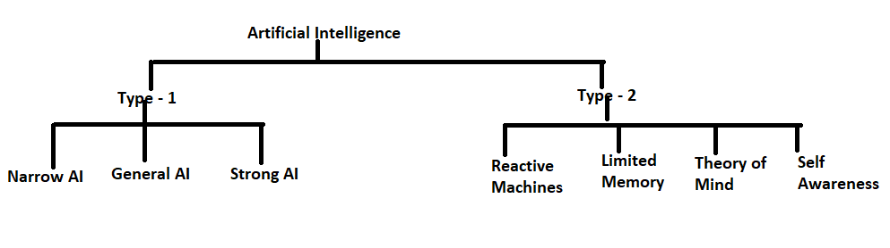
Types of Artificial Intelligence:
Artificial Intelligence can be divided in various types, there are mainly two types of main categorization which are based on capabilities and based on functionally of AI.
Following is flow diagram which explain the types of AI.

Slide 39
1. Weak AI or Narrow AI:
  Narrow AI is a type of AI which is able to perform a dedicated task with intelligence.The most common and currently available AI is Narrow AI in the world of Artificial Intelligence.
Narrow AI cannot perform beyond its field or limitations, as it is only trained for one specific task. Hence it is also termed as weak AI. Narrow AI can fail in unpredictable ways if it goes beyond its limits.
Apple Siri is a good example of Narrow AI, but it operates with a limited pre-defined range of functions.

Slide 40
Some Examples of Narrow AI are playing chess, purchasing suggestions on e-commerce site, self-driving cars, speech recognition, and image recognition.

Slide 41
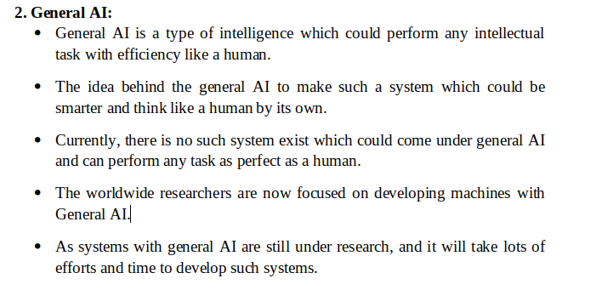

Slide 42
General AI Capabilities
The ability to think abstractly
Gathering and drawing from background knowledge of multiple subjects
Common sense and consciousness
Causation–a thorough understanding of cause and effect

Slide 43
Example -GAI
ChatGPT: A natural language processing tool driven by AI technology that allows you to have human-like conversations and much more with a chatbot.
The language model can answer questions, and assist you with tasks such as composing emails, essays, and code.

Slide 44
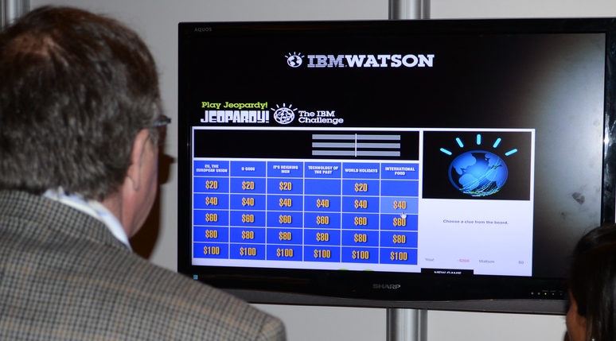
IBM's Watson supercomputer also comes under Narrow AI, as it uses an Expert system approach combined with Machine learning and natural language processing.
In 2011, Watson competed on the “Jeopardy!” television show against top human contestants and won the first-place prize. Since then, Watson has been used for utilization management in medical centers.

Slide 45
CHALLENGES IN HEALTHCARE SECTOR
Healthcare being a patient-intensive industry, its success relies on
Real-time, quick diagnosis
Treatment decisions-Due to rising global disease burden,
growing traffic of patients,
mismanagement of medical prescriptions,
challenges of rare diseases,
Lack of connectivity for collaborative treatment,
Growing load of patient data are vital challenges to be addressed in the healthcare sector.
Watson-Advantage of cloud technology, improved machine learning and hardware capabilities addressing the healthcare challenges.

Slide 46
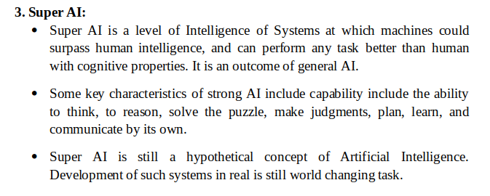

Slide 47
Narrow AI – Dedicated for one task
General AI – Performs like human
Super AI – Intelligent than human

Slide 48
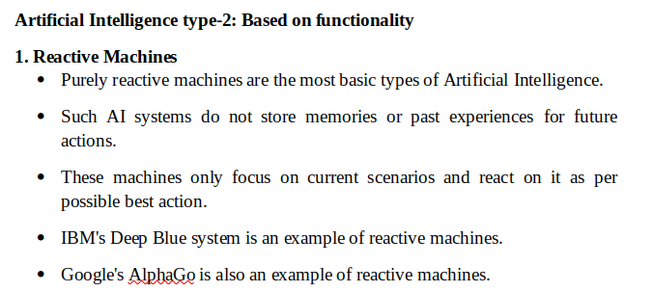

Slide 49
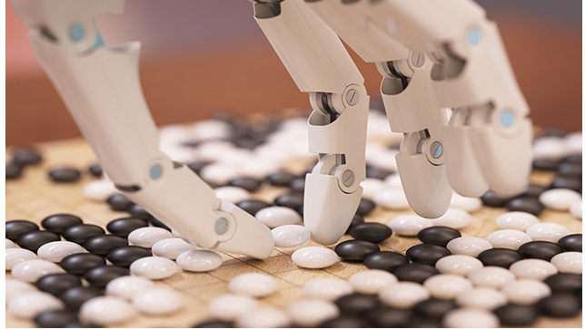
Google-AlphaGo
Becoming the first program to defeat a professional player.

Slide 50
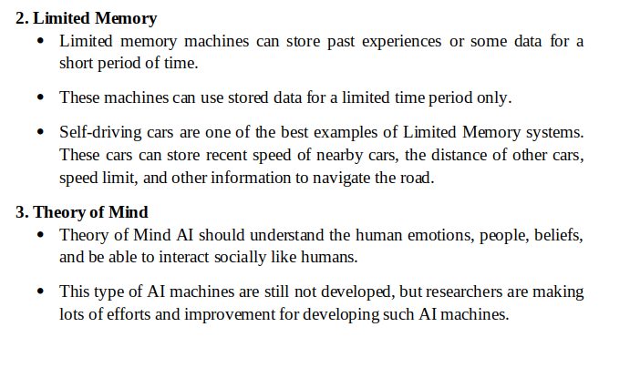

Slide 51
4. Self-Awareness
Self-awareness AI is the future of Artificial Intelligence. These machines will be super intelligent, and will have their own consciousness, sentiments, and self-awareness.
These machines will be smarter than human mind.
Self-Awareness AI does not exist in reality still and it is a hypothetical concept.

Slide 52
Since the emergence of AI in the 1950s, we have seen an exponential growth in its potential.
AI cover domains such as machine learning, deep learning, neural networks, natural language processing, knowledge base, expert systems, and so on.
It has also made its way into computer vision and image processing.

Slide 53
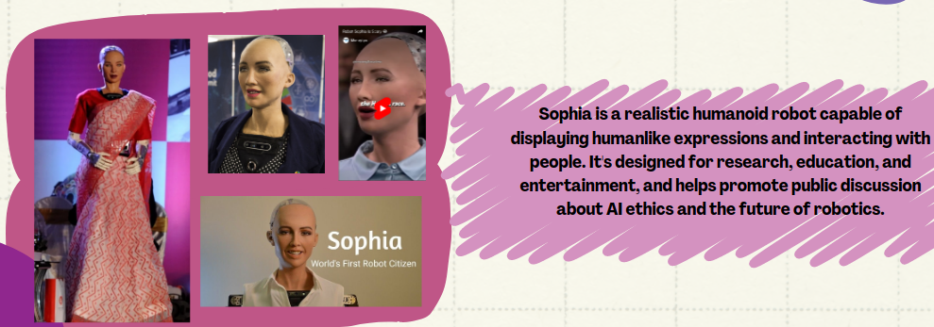
Sophia-AI Robot

Slide 54
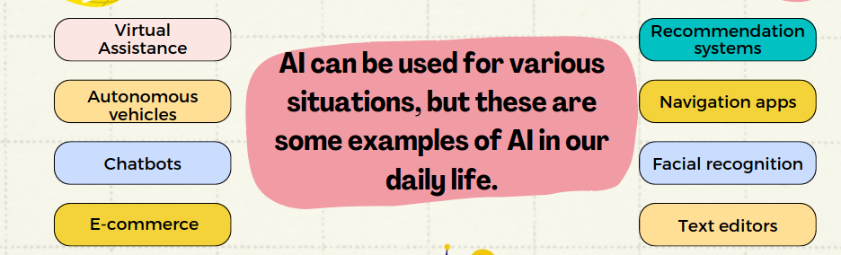

Slide 55
THANK YOU

Slide 56
What is Machine Learning?
The term machine learning was first introduced by Arthur Samuel in 1959. We can define it in a summarized way as:
Machine learning enables a machine to automatically learn from data, improve performance from experiences, and predict things without being explicitly programmed.
Machine learning is an important component of the growing field of data science, a branch of artificial intelligence (AI) and computer science which focuses on the use of data and algorithms to imitate the way that humans learn.
Machine learning brings computer science and statistics together for creating predictive models.
The more we will provide the information, the higher will be the performance.

Slide 57
What is Machine Learning?
• Machine learning uses various algorithms for building mathematical models and making predictions using historical data or information.
• Currently, it is being used for various tasks such as image recognition, speech recognition, email filtering, Facebook auto-tagging, recommender system, and many more.
• Machine Learning is said as a subset of artificial intelligence that is mainly concerned with the development of algorithms which allow a computer to learn from the data and past experiences on their own.

Slide 58
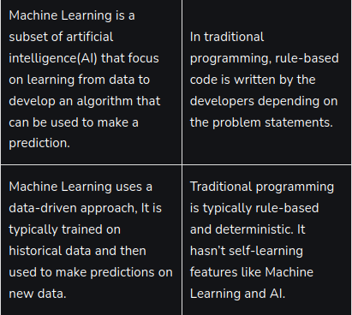
Machine Learning vs. Traditional Programming

Slide 59
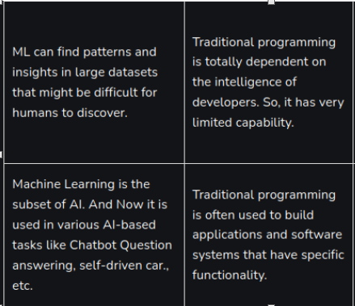
Machine Learning vs. Traditional Programming

Slide 60
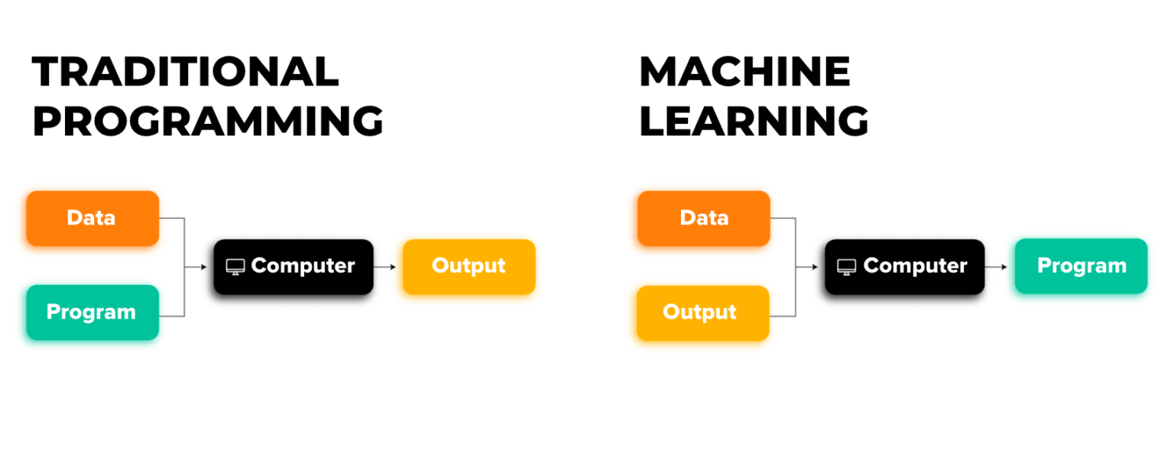

Slide 61
Traditional Programming | ML Programming
Traditional Programming refers to any manually created program that uses input data and runs on a computer to produce the output. | The input data and output are fed to an algorithm to create a program. This yields powerful insights that can be used to predict future outcomes.
Each rule is based on a logical foundation; the machine will execute an output following the logical statement. When the system grows complex, more rules need to be written. It can quickly become unsustainable to maintain. | The machine learns how the input and output data are correlated and it writes a rule. The programmers do not need to write new rules each time there is new data.

Slide 62
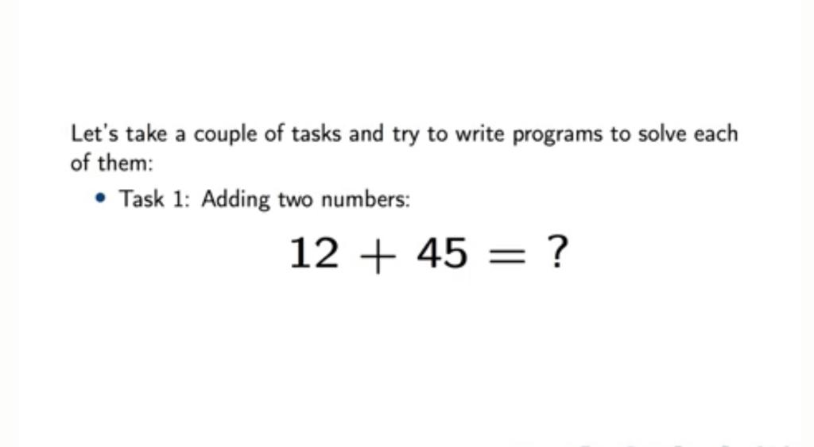

Slide 63
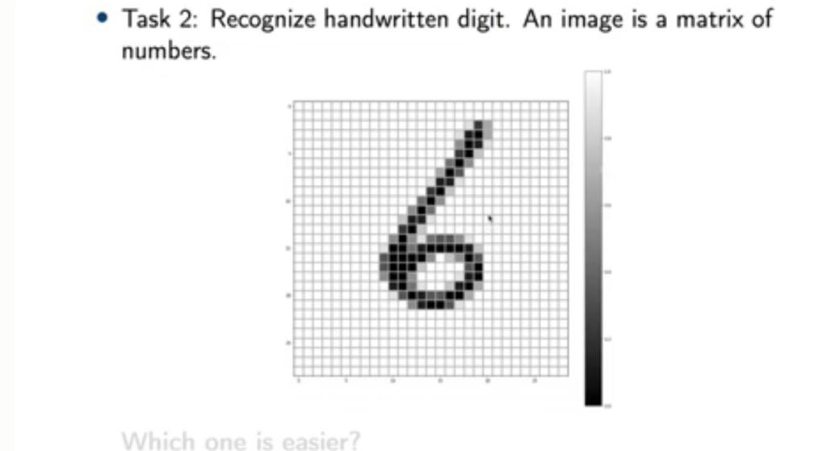

Slide 64
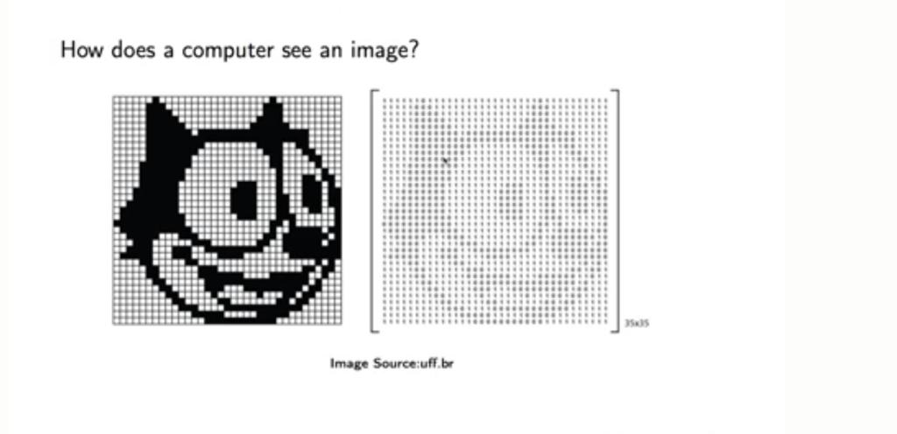

Slide 65
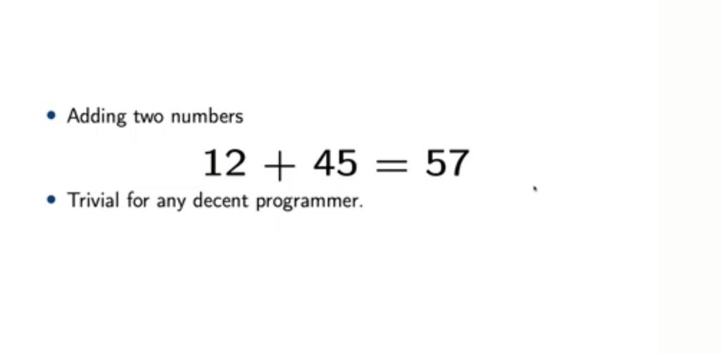

Slide 66
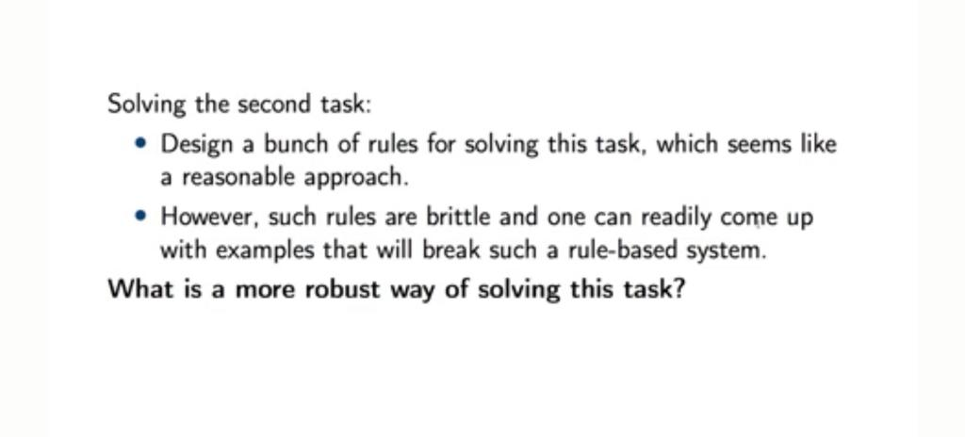

Slide 67
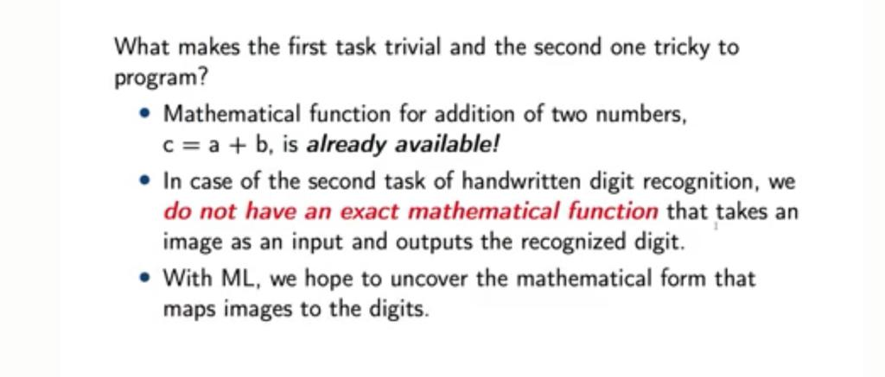

Slide 68
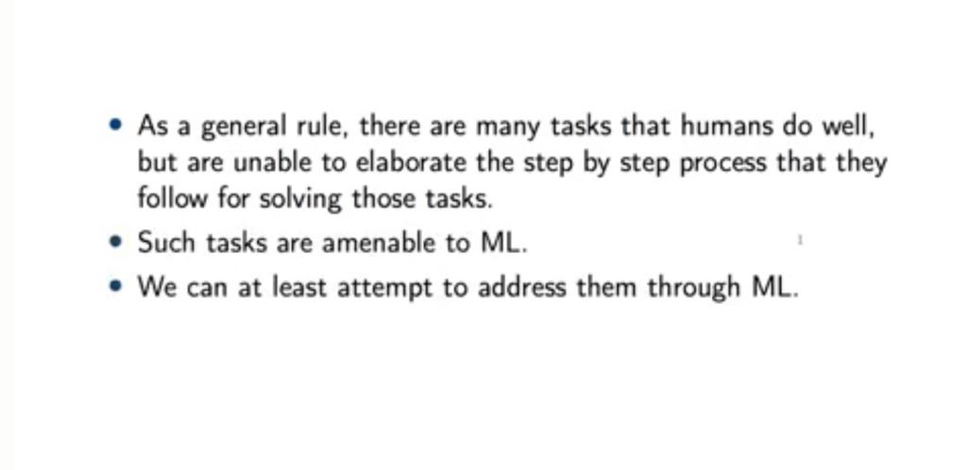

Slide 69
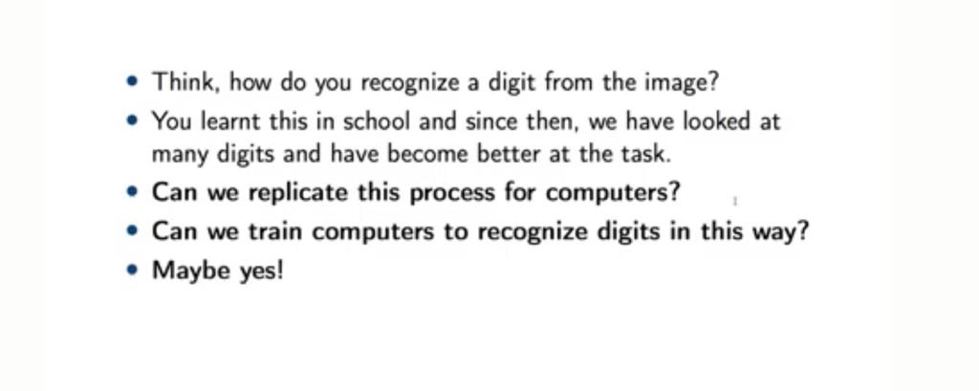

Slide 70
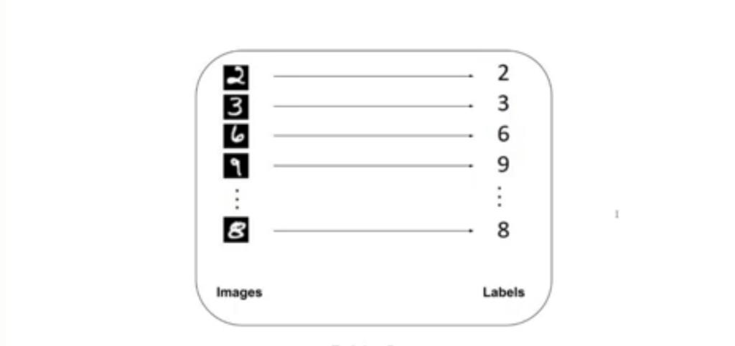

Slide 71
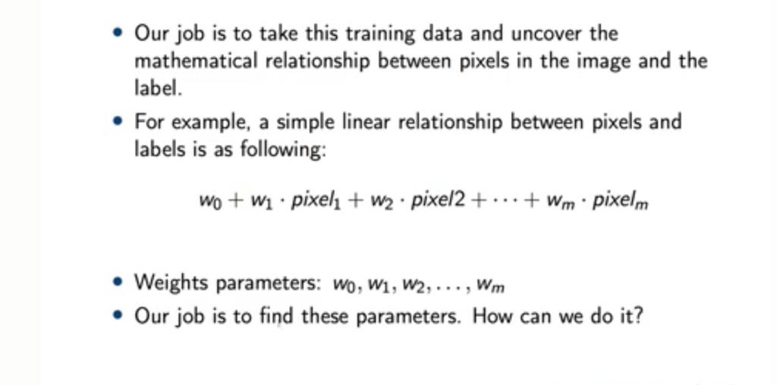

Slide 72
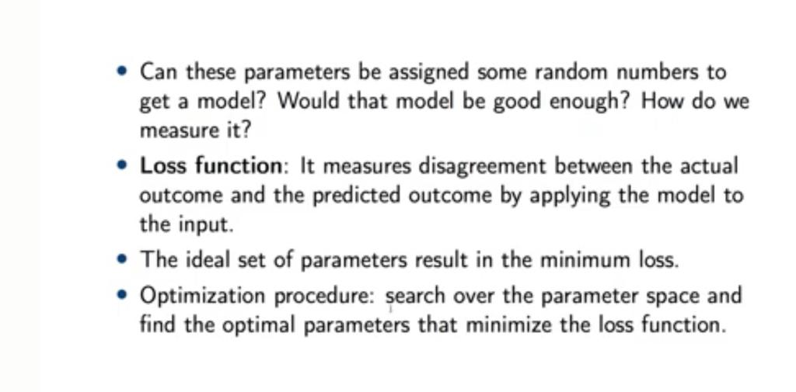

Slide 73
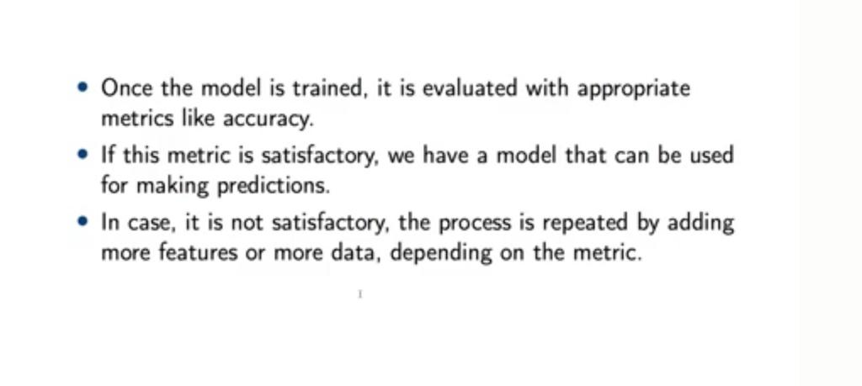

Slide 74
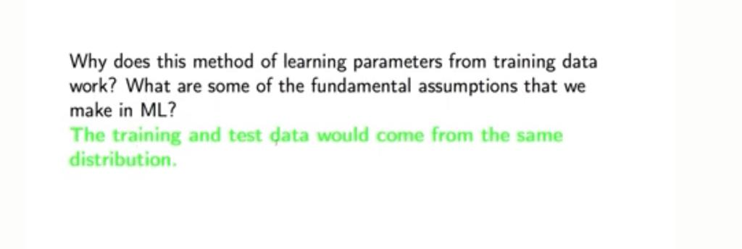

Slide 75
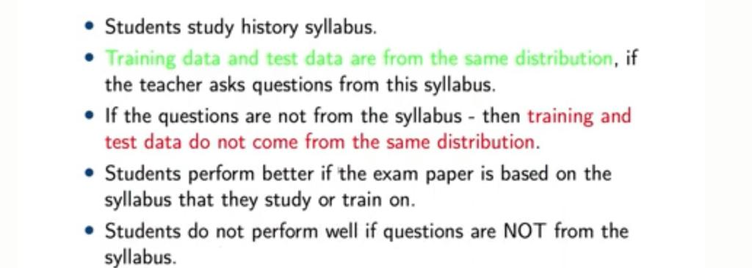

Slide 76
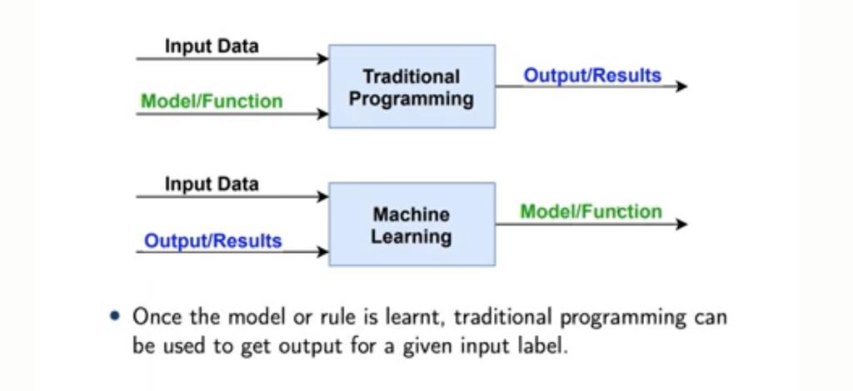

Slide 77
Need for Machine Learning
The need for machine learning is increasing day by day. The reason behind the need for machine learning is that it is capable of doing tasks that are too complex for a person to implement directly.
As a human, we have some limitations as we cannot access the huge amount of data manually.
We can train machine learning algorithms by providing them the huge amount of data and let them explore the data, construct the models, and predict the required output automatically.

Slide 78
Need for Machine Learning
• With the help of machine learning, we can save both time and money.
• The importance of machine learning can be easily understood by its uses cases.
• Currently, machine learning is used in self-driving cars, cyber fraud detection, face recognition, and friend suggestion by Facebook, etc.
• Various top companies such as Netflix and Amazon have built machine learning models that are using a vast amount of data to analyze the user interest and recommend product accordingly.

Slide 79
Importance of Machine Learning
• Rapid increment in the production of data.
• Solving complex problems.
• Decision making in various sector including finance
• Finding hidden patterns and extracting useful information from data.

Slide 80
Challenges in Machine Learning
1. Data Collection
• Data plays a key role in any use case. 60% of the work of a data scientist lies in collecting the data. For beginners to experiment with machine learning, they can easily find data from Kaggle, UCI ML Repository, etc.
• To implement real case scenarios, you need to collect the data through web-scraping or (through APIs like twitter) or for solving business problems you need to attain data from clients (here ML engineers need to coordinate with domain experts to collect the data).
• Once the data is collected, we need to structure the data and store it in the database. This requires knowledge of Big data (or data engineer) which plays a major role here.

Slide 81
Challenges in Machine Learning
2. Less Amount of Training Data
• Once the data is collected you need to validate if the quantity is sufficient for the use case (if it is a time-series data, we need a minimum of 3–5 years of data).
• The two important things we do while doing a machine learning project are selecting a learning algorithm and training the model using some of the acquired data.

Slide 82
Challenges in Machine Learning
• Similarly, we train the model with a lot of data. A child may distinguish the animal with less number of samples, but a machine learning model requires thousands of examples for even simple problems.
For complex problems like Image Classification and Speech Recognition, it may require data in a large volume.
• Therefore, we need to train a model with sufficient DATA.

Slide 83
Challenges in Machine Learning
3. Non-representative Training Data
• The training data should be representative of the new cases to generalize well i.e., the data we use for training should cover all the cases that occurred and that is going to occur. By using a non-representative training set, the trained model is not likely to make accurate predictions.
• Systems which are developed to make predictions for generalized cases in business problem view are said to be good machine learning models. It will help the model to perform well even for the data which the data model has never seen.
• If the number of training samples is low, we have sampling noise which is unrepresentative data.
To make accurate predictions without any drifts, the training datasets must be representative.

Slide 84
Challenges in Machine Learning
4. Poor Quality of Data
• Analyzing data is the most important step. But the data we collected might not be ready for training, some samples are abnormal from others having outliers or missing values .
• In these cases, we can remove the outliers, or fill the missing features/values using median or mean (to fill height) or simply remove the attributes/instances with missing values, or train the model with and without these instances.

Slide 85
Challenges in Machine Learning
• We don’t want our system to make false predictions. So the quality of data is very important to get accurate results.
Data preprocessing needs to be done by filtering missing values, extract & rearrange what the model needs.

Slide 86
Challenges in Machine Learning
5. Irrelevant/Unwanted Features
• If the training data contains a large number of irrelevant features and enough relevant features, the machine learning system will not give the results as expected.
One of the important aspects required for the success of a machine learning project is the selection of good features to train the model also known as Feature Selection.
• For example if we need to predict the number of hours a person needs to exercise based on the input features that we collected — age, gender, weight, height, and location (i.e., where he/she lives).
• Among these 5 features, location value might not impact our output function. This is an irrelevant feature, we know that we can have better results without this feature.

Slide 87
Challenges in Machine Learning
• Also, we can combine two features to produce a more useful one i.e., Feature Extraction. In our example,
• Creating new features by gathering more data also helps.

Slide 88
Challenges in Machine Learning
6. Overfitting the Training Data
When a model performs very well for training data but gives a poor performance with test data.
Overfitting happens due to several reasons, such as:
The training data size is too small and does not contain enough data samples to accurately represent all possible input data values.
• The training data contains large amounts of irrelevant information, called noisy data
• It means the model is performing well, making likely predictions on the training dataset, but it is not generalized well.

Slide 89
Challenges in Machine Learning
• Example is suppose you are attempting to implement an Image Classification model to classify apple, peach, oranges, bananas with training samples of — 3000, 500, 500, 500 respectively. If we train the model with these samples the system is more likely to classify oranges as apples as the number of training samples for apples is too high. This can be referred to as Oversampling.
• At the point when the model is excessively unpredictable when compared to the noisiness of the training dataset, overfitting occurs.
We can avoid it by: Gathering more training data.
• Fix data errors, remove the outliers, and reduce the number of instances in the training set.

Slide 90
Challenges in Machine Learning
7. Underfitting the Training data
• Underfitting which is opposite to overfitting generally occurs when the model is too simple to understand the base structure of the data.
• It generally happens when we have less information to construct an exact model. Example: Human behavior.
• Main options to reduce underfitting are:
• Feature Engineering — feeding better features to the learning algorithm.
• Removing noise from the data.
• Increasing parameters and selecting a powerful model.

Slide 91
Challenges in Machine Learning
8. Offline Learning & Deployment of the model
• Machine Learning engineering follows these steps while building an application
1) Data collection
2) Data cleaning
3) Feature engineering
4) Analyzing patterns
5) Training the model and Optimization
6) Deployment.
• A lot of machine learning practitioners can perform all steps but can lack the skills for deployment.

Slide 92
Challenges in Machine Learning
• Bringing their applications into production has become one of the biggest challenges due to lack of practice and dependencies issues, low understanding of underlying models with business, understanding of business problems, unstable models.
• Generally, many of the developers collect data from websites like Kaggle and start training the model. But in reality, we need to make a source for data collection, that varies dynamically. (like stock ticker data, or continuous data) The system is trained and then it is launched into production, runs without learning anymore. Here the data might drift as it changes dynamically.
• It is always preferred to build a pipeline to collect, analyze, build/train, test & validate the dataset for any machine learning project and train the model in batches.

Slide 93
Challenges in Machine Learning
A system doesn’t perform well if the training set is too small, or if the data is not generalized, noisy, and corrupted with irrelevant features.

Slide 94
Supervised Machine Learning
Supervised machine learning is a type of machine learning that learns the relationship between input and output.
The inputs are known as features or ‘X variables’ and output is generally referred to as the target or ‘y variable’.

Slide 95
Supervised Machine Learning
The aim of a supervised learning algorithm is to find a mapping function to map the input variable(x) with the output variable(y).
Supervised learning uses algorithms that learn the relationship of Features and Target from the dataset. This process is referred to as Training.
In the real-world, supervised learning can be used for Risk Assessment, Image classification, Fraud Detection, spam filtering, etc.

Slide 96
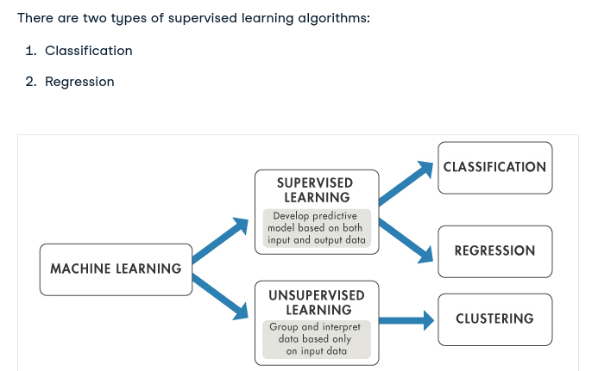
Supervised Machine Learning

Slide 97
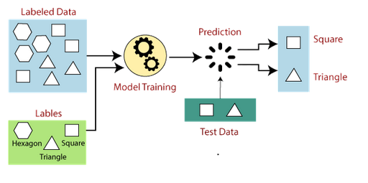
How Supervised Learning Works?

Slide 98
Suppose we have a dataset of different types of shapes which includes square, rectangle, triangle, and Polygon. Now the first step is that we need to train the model for each shape.
If the given shape has four sides, and all the sides are equal, then it will be labelled as a Square.
If the given shape has three sides, then it will be labelled as a triangle.
If the given shape has six equal sides then it will be labelled as hexagon.
Now, after training, we test our model using the test set, and the task of the model is to identify the shape.
The machine is already trained on all types of shapes, and when it finds a new shape, it classifies the shape on the bases of a number of sides, and predicts the output.

Slide 99
Steps Involved in Supervised Learning:
First Determine the type of training dataset
Collect/Gather the labelled training data.
Split the training dataset into training dataset, test dataset, and validation dataset.
Determine the input features of the training dataset, which should have enough knowledge so that the model can accurately predict the output.
Determine the suitable algorithm for the model, such as support vector machine, decision tree, etc.

Slide 100
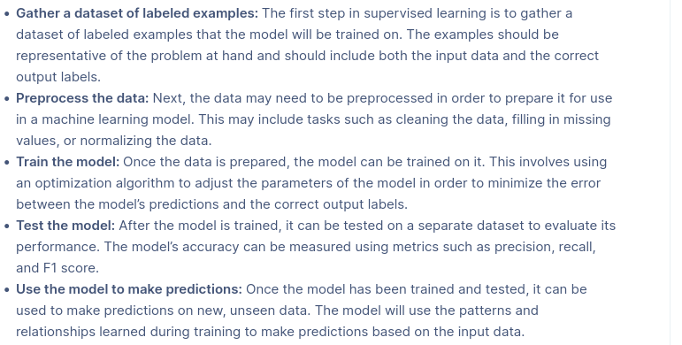
STEPS IN SUPERVISED LEARNING

Slide 101
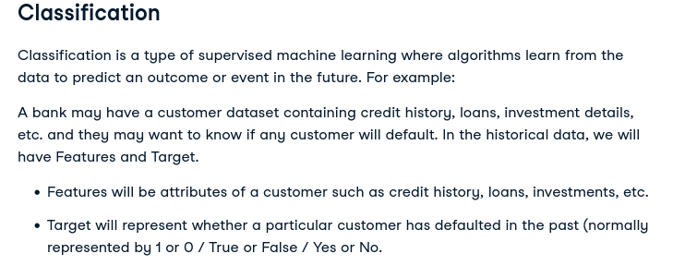

Slide 102
Classification algorithms are used for predicting discrete outcomes, if the outcome can take two possible values such as True or False, Default or No Default, Yes or No, it is known as Binary Classification.
When the outcome contains more than two possible values, it is known as Multiclass Classification. There are many machine learning algorithms that can be used for classification tasks. Some of them are:
Logistic Regression
Decision Tree Classifier
K Nearest Neighbor Classifier
Random Forest Classifier
Neural Networks

Slide 103
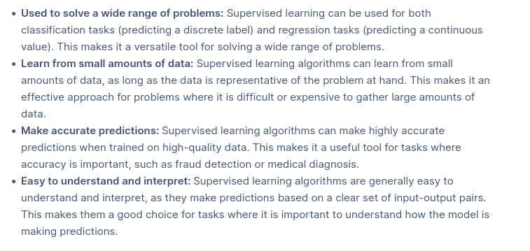
ADVANTAGES

Slide 104
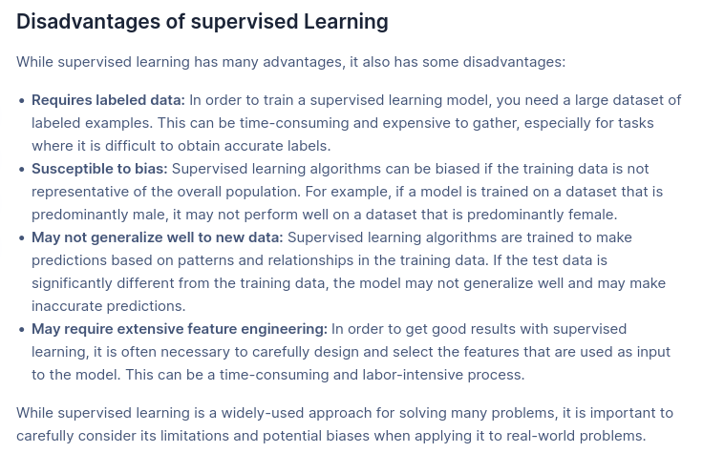
DISADVANTAGES

Slide 105
UNSUPERVISED LEARNING
Unsupervised learning is a type of machine learning in which models are trained using unlabeled dataset and itself find the hidden patterns and insights from the given data.
The goal of unsupervised learning is to find the underlying structure of dataset, group that data according to similarities, patterns, and differences.

Slide 106
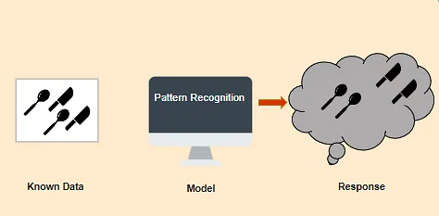
UNSUPERVISED LEARNING

Slide 107
TYPES -UNSUPERVISED LEARNING
1.CLUSTERING
2.ASSOCIATION

Slide 108
IMPORTANCE-UNSUPERVISED LEARNING
• Unsupervised learning is helpful for finding useful
insights from the data.
• Unsupervised learning is much similar as a human learns to think by their own experiences, which makes it closer to the real AI.
• Unsupervised learning works on unlabeled and
uncategorized data which make unsupervised learning more important.
• In real-world, we do not always have input data with the corresponding output so to solve such cases, we
need unsupervised learning.

Slide 109
ADAVANTAGES & DISADVANTAGES
ADAVANTAGES
Unsupervised learning is used for more complex tasks as compared to supervised learning because, in unsupervised learning, we don't have labeled input data.
Unsupervised learning is preferable as it is easy to get unlabeled data in comparison to labeled data.
DISADVANTAGES
Unsupervised learning is intrinsically more difficult than supervised learning as it does not have corresponding output.
The result of the unsupervised learning algorithm might be less accurate as input data is not labeled, and algorithms do not know the exact output in advance.

Slide 110
ALGORITHMS
K-means clustering
• Hierarchal clustering
• Anomaly detection
• Neural Networks
• Principle Component Analysis
• Independent Component Analysis

Slide 111
Clustering
Clustering is a method of grouping the objects into clusters such that objects with most similarities remains into a group and has less or no similarities with the objects of another group.
Cluster analysis finds the commonalities between the data objects and categorizes them as per the presence and absence of those commonalities.

Slide 112
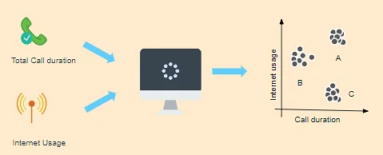
CLUSTERING

Slide 113
EXAMPLE
Suppose a telecom company wants to reduce its customer churn rate by providing personalized call and data plans.
The behavior of the customers is studied and the model segments the customers with similar traits.
Several strategies are adopted to minimize churn rate and maximize profit through suitable promotions and campaigns.
On the right side of the image, you can see a graph where customers are grouped.
Group A customers use more data and also have high call durations. Group B customers are heavy Internet users, while Group C customers have high call duration.
So, Group B will be given more data benefit plants, while Group C will be given cheaper called call rate plans and group A will be given the benefit of both.

Slide 114
Association
An association rule is an unsupervised learning method which is used for finding the relationships between variables in the large database.
It determines the set of items that occurs together in the dataset.
Association rule makes marketing strategy more effective.
Such as people who buy X item (suppose a bread) are also tend to purchase Y (Butter/Jam) item. A typical example of Association rule is Market Basket Analysis.

Slide 115
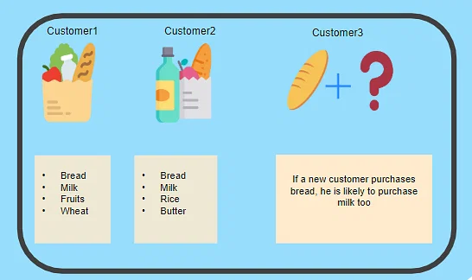
EXAMPLE
Let’s say that a customer goes to a supermarket and buys bread, milk, fruits, and wheat.
Another customer comes and buys bread, milk, rice, and butter. Now, when another customer comes, it is highly likely that if he buys bread, he will buy milk too.
Hence, a relationship is established based on customer behavior and recommendations are made.

Slide 116
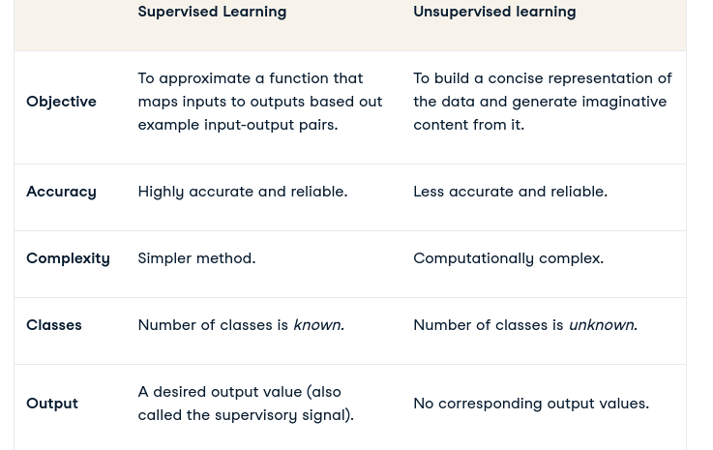

Slide 117
APPLICATIONS
• Natural language processing (NLP). Google News is known to leverage unsupervised learning to categorize articles based on the same story from various news outlets.
• Image and video analysis. Visual Perception tasks such as object recognition leverage unsupervised learning.
• Anomaly detection. Unsupervised learning is used to identify data points, events, and/or observations that deviate from a dataset's normal behavior.
• Customer segmentation. Interesting buyer persona profiles can be created using unsupervised learning. This helps businesses to understand their customers' common traits and purchasing habits.
• Recommendation Engines. Past purchase behavior coupled with unsupervised learning can be used to help businesses discover data trends that they could use to develop effective cross-selling strategies.

Slide 118
REINFORCEMENT LEARNING
Reinforcement learning (RL) is a subset of machine learning that allows an AI-driven system (sometimes referred to as an agent) to learn through trial and error using feedback from its actions.
This feedback is either negative or positive, signalled as punishment or reward with, of course, the aim of maximising the reward function.
RL learns from its mistakes and offers artificial intelligence that mimics natural intelligence as closely as it is currently possible.
That is, it requires a large number of interactions between the agent and the environment to collect data for training.

Slide 119
REINFORCEMENT LEARNING
Reinforcement learning does not rely on a static dataset, but operates in a dynamic environment and learns from collected experiences.
Data points, or experiences, are collected during training through trial-and-error interactions between the environment and a software agent.
This aspect of reinforcement learning is important, because it alleviates the need for data collection, preprocessing, and labeling before training, otherwise necessary in supervised and unsupervised learning.
Practically, this means that, given the right incentive, a reinforcement learning model can start learning a behavior on its own, without (human) supervision.

Slide 120
REINFORCEMENT LEARNING
Reinforcement Learning (RL) is the science of decision making. It is about learning the optimal behavior in an environment to obtain maximum reward.
Reinforcement learning uses algorithms that learn from outcomes and decide which action to take next. After each action, the algorithm receives feedback that helps it determine whether the choice it made was correct, neutral or incorrect. It is a good technique to use for automated systems that have to make a lot of small decisions without human guidance.

Slide 121
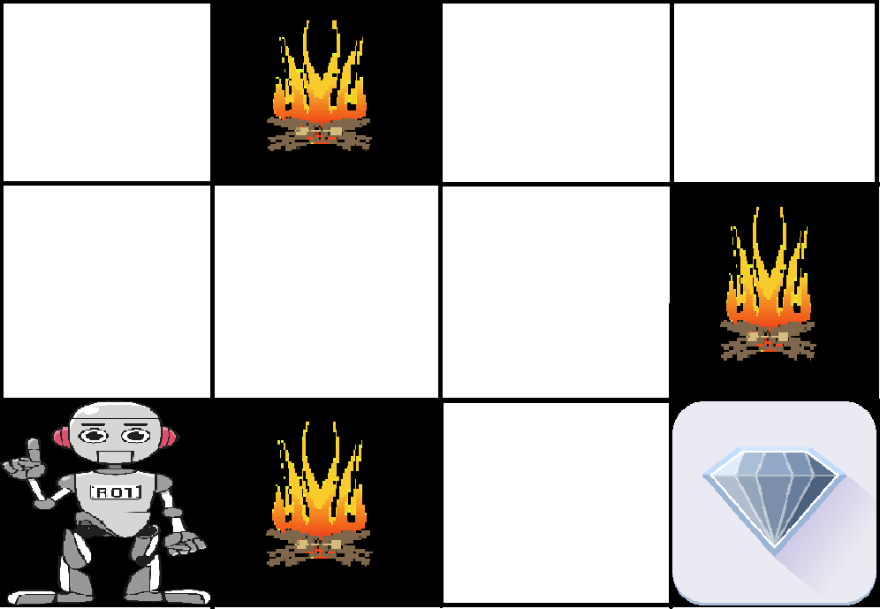
EXAMPLE
The problem is as follows: We have an agent and a reward, with many hurdles in between. The agent is supposed to find the best possible path to reach the reward. The following problem explains the problem more easily.

Slide 122
REINFORCEMENT LEARNING
The above image shows the robot, diamond, and fire. The goal of the robot is to get the reward that is the diamond and avoid the hurdles that are fired. The robot learns by trying all the possible paths and then choosing the path which gives him the reward with the least hurdles. Each right step will give the robot a reward and each wrong step will subtract the reward of the robot. The total reward will be calculated when it reaches the final reward that is the diamond.
Main points in Reinforcement learning –
Input: The input should be an initial state from which the model will start
Output: There are many possible outputs as there are a variety of solutions to a particular problem
Training: The training is based upon the input, The model will return a state and the user will decide to reward or punish the model based on its output.
The model keeps continues to learn.
The best solution is decided based on the maximum reward.

Slide 123
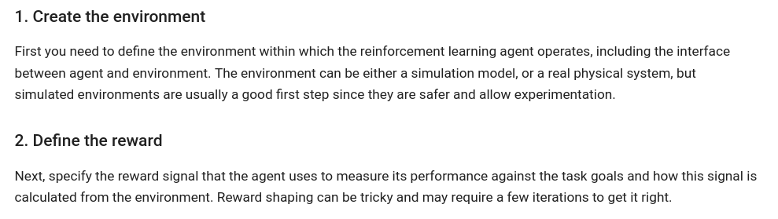
STEPS

Slide 124
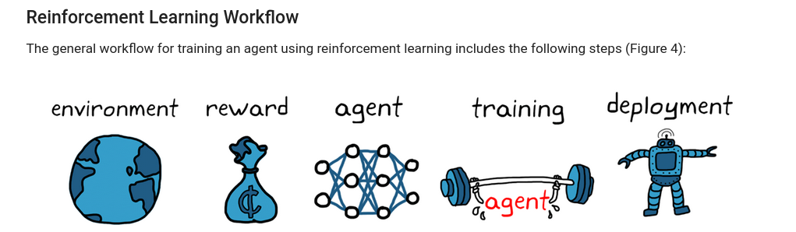

Slide 125
REINFORCEMENT LEARNING
4. Train and validate the agent:
Set up training options (like stopping criteria) and train the agent to tune the policy.
Make sure to validate the trained policy after training ends.
If necessary, revisit design choices like the reward signal and policy architecture and train again.

Slide 126
REINFORCEMENT LEARNING-APPLICATIONS
1. Robotics: Robots with pre-programmed behavior are useful in structured environments, such as the assembly line of an automobile manufacturing plant, where the task is repetitive in nature.
2. A master chess player makes a move. The choice is informed both by planning, anticipating possible replies and counter replies.
3. An adaptive controller adjusts parameters of a petroleum refinery’s operation in real time.

Slide 127
Advantages of Reinforcement Learning
Advantages of Reinforcement learning
1. Reinforcement learning can be used to solve very complex problems that cannot be solved by conventional techniques.
2. The model can correct the errors that occurred during the training process.
3. In RL, training data is obtained via the direct interaction of the agent with the environmentchniques, such as deep learning, to improve performance.

Slide 128
Advantages of Reinforcement Learning
4. Reinforcement learning can handle environments that are non-deterministic, meaning that the outcomes of actions are not always predictable. This is useful in real-world applications where the environment may change over time or is uncertain.
5. Reinforcement learning can be used to solve a wide range of problems, including those that involve decision making, control, and optimization.
6. Reinforcement learning is a flexible approach that can be combined with other machine learning techniques, such as deep learning, to improve performance.

Slide 129
Disdvantages of Reinforcement Learning
1. Reinforcement learning is not preferable to use for solving simple problems.
2. Reinforcement learning needs a lot of data and a lot of computation
3. Reinforcement learning is highly dependent on the quality of the reward function. If the reward function is poorly designed, the agent may not learn the desired behavior.
4. Reinforcement learning can be difficult to debug and interpret. It is not always clear why the agent is behaving in a certain way, which can make it difficult to diagnose and fix problems.

Slide 130
